Slide 1
Introduction & Problem Statement
Skin cancer is the most common cancer globally, with melanoma being the most deadly form.
Melanoma, specifically, is responsible for 75% of skin cancer deaths, despite being the least common skin cancer.
Considering the ISIC challenge, our team has taken up following tasks:
Segmentation of Skin Lesions from Dermoscopic images.
Classification of Dermoscopic images into different categories and determining whether the predicted class of skin disease is Benign or Malignant.

Slide 2
Skin Lesion Segmentation
Skin lesion segmentation has a critical role in the early and accurate diagnosis of skin cancer by computerized systems
Segmentation is an important task in analysing skin lesion images.
Skin lesion segmentation has come with some challenges such as low contrast and fine grained nature of skin lesions.
A Deep Learning Model is adapted using Fully Convolutional Networks(FCNs) based on U-Net architecture or other equivalent variants of the U-Net.

Slide 3
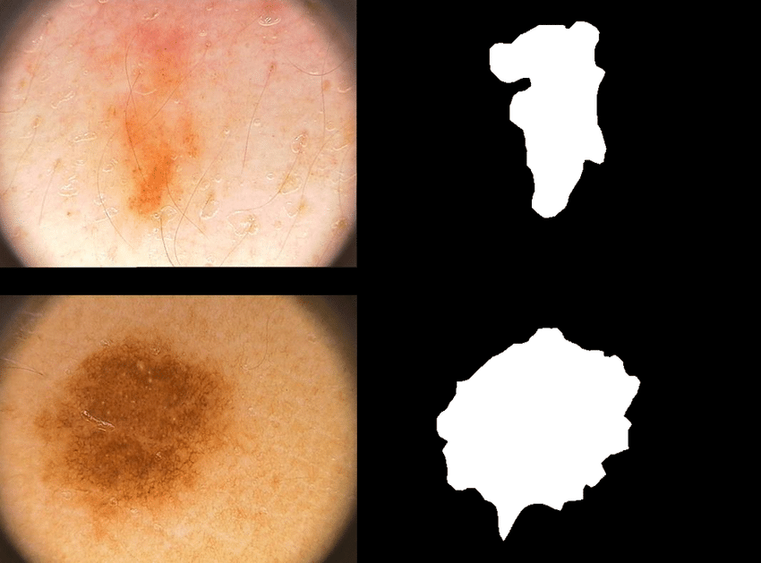
Essential Datasets
PH² :
The PH² dataset has been developed for research and benchmarking purposes, in order to facilitate comparative studies on both segmentation and classification algorithms of dermoscopic images.
PH² database contains a total of 200 dermoscopic images of melanocytic lesions, including 80 common nevi, 80 atypical nevi, and 40 melanomas with dimensions 768x560 pixels.

Slide 4





Evaluation Metrics
Jaccard index:
Dice Coefficient:
Sensitivity(True Positive Rate):
Specificity(True Negative Rate):
Accuracy:

Slide 5
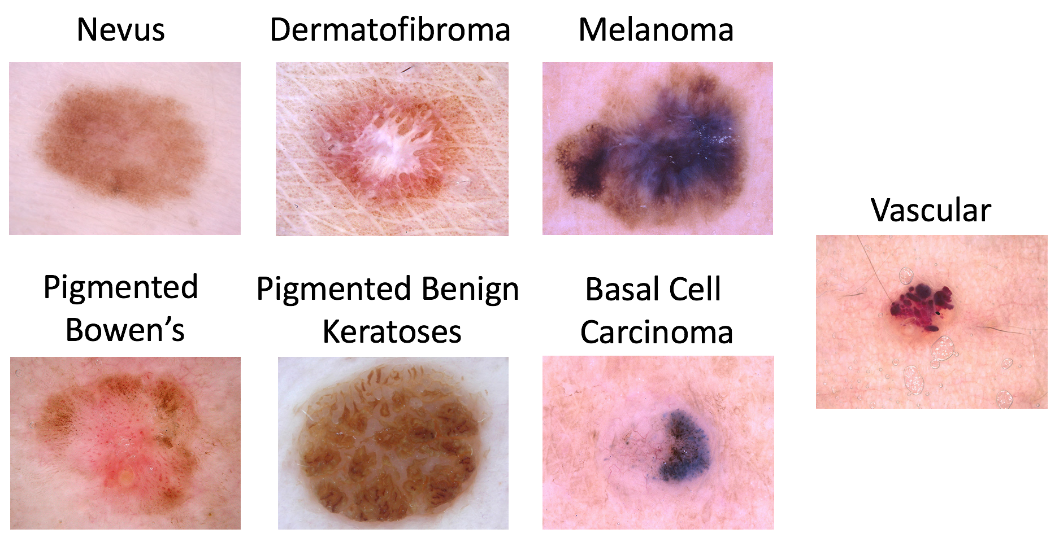
Skin Lesion Disease Classification
Accurate detection of melanoma and high classification rates are very essential in the early detection of skin cancer.
For the purpose of Lesion diagnosis, We will use the HAM10000 dataset. The disease classification is as follows:

Slide 6
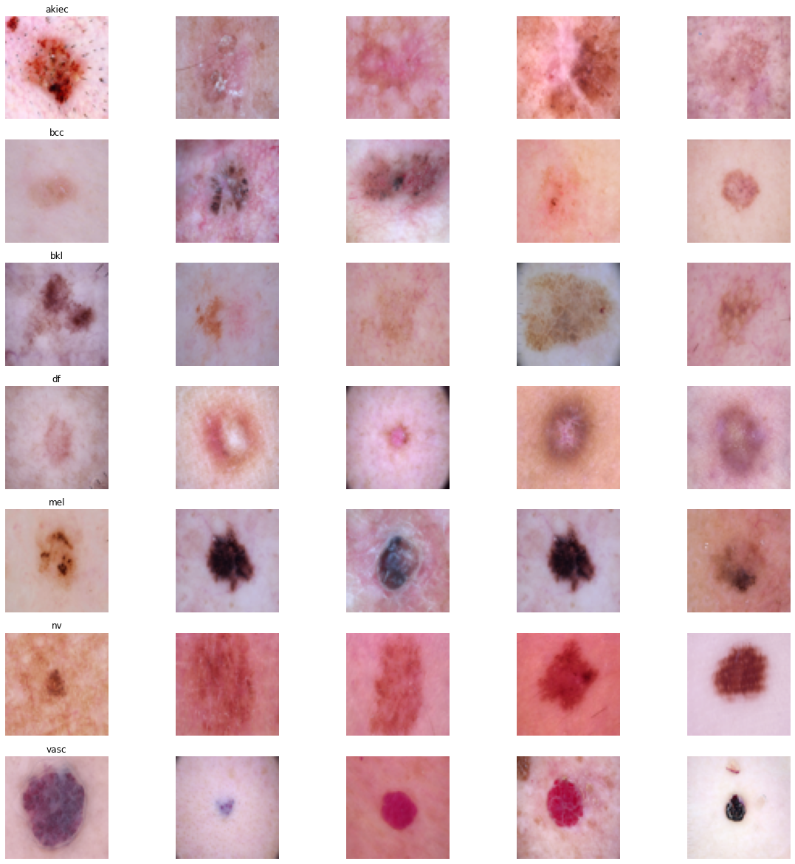
Essential Dataset
HAM10000 :
Training of neural networks for automated diagnosis of pigmented skin lesions is hampered by the small size and lack of diversity of available dataset of dermatoscopic images.
HAM10000 dataset consists of 10015 dermatoscopic images which can serve as a training set for academic machine learning purposes. The dimension of images in this dataset is 600x450 pixels.

Slide 7
Evaluation Metrics
Goal Metric:
Normalized multi-class accuracy metric
Other Metrics:
Individual Category Metrics
Sensitivity
Specificity
Area under the receiver operator characterstic Curve (AUC)
Mean Average Precision
F1 Score
Aggregate Metrics
average AUC across all diagnoses
malignant vs. benign diagnoses category AUC

Slide 8
References:
Web Links:
ISIC Archive
ISIC-2018 Challenge
PH2 Database
Kaggle HAM10000 Dataset
Evaluation Metrics(Wikipedia)
Research Paper:
Skin Lesion Analysis Toward Melanoma Detection 2018: A Challenge Hosted by the International Skin Imaging Collaboration (ISIC) (https://arxiv.org/pdf/1902.03368.pdf)

